Slide 1




MBC 638: Data Analysis & Decision Making
Anna Chernobai
Lecture 05 – PART 3:
Simple and multiple regressions (Chapter 10)

Slide 2
Today: Regression analysis
0. Recall (Lecture 04): Association among numerical variables
Scatterplots
Covariance and Correlation
Simple linear regression
Multiple linear regression
Linear regressions with dummy variables and interaction variables
Nonlinear modeling possibilities

Slide 3



1. Regression with dummy variables
Data: Bank Salaries.xlsx
The Fifth National Bank of Springfield is facing a gender discrimination suit. The charge is that its female employees receive substantially smaller salaries than its male employees.
We have data on 208 employees.
Let’s use the data to figure out whether this claim is valid!

Slide 4
3. Regression with dummy variables
Dummy variables in regression models
Use Bank Salaries.xlsx data. (See Example 10.3 on page 561 of the textbook.)

Slide 5
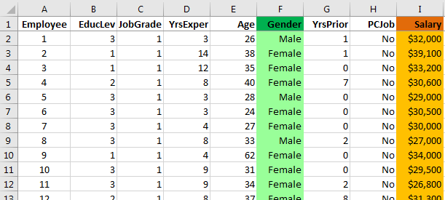
3. Regression with dummy variables
QUESTION: DOES GENDER AFFECT SALARY?

Slide 6
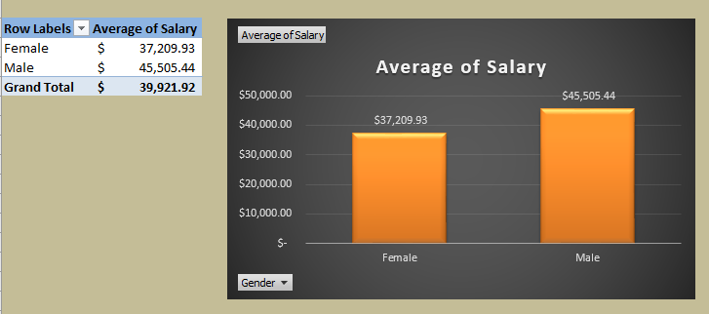
3. Regression with dummy variables
QUESTION: DOES GENDER AFFECT SALARY?
Let’s begin by looking at descriptive statistics: use Pivot Table and Pivot Chart to compare average salary for male and female employees.

Slide 7
3. Regression with dummy variables
QUESTION: DOES GENDER AFFECT SALARY?
It seems like female employees are underpaid by an average of $8,295.5.

Slide 8
3. Regression with dummy variables
QUESTION: DOES GENDER AFFECT SALARY?
It seems like female employees are underpaid by an average of $8,295.5.
But don’t jump to conclusions too fast!!
This finding is based only on a sample of 208 employees.
We have not controlled for other potentially important factors, such as years of experience, education, and job type.

Slide 9

3. Regression with dummy variables
QUESTION: DOES GENDER AFFECT SALARY?
It seems like female employees are underpaid by an average of $8,295.5.
But don’t jump to conclusions too fast!!
This finding is based only on a sample of 208 employees.
We have not controlled for other potentially important factors, such as years of experience, education, and job type.
Let’s use a regression model to see if GENDER affects SALARY.
Problem: GENDER is a nominal categorical variable…
But regressions may include only numerical variables…

Slide 10
3. Regression with dummy variables
QUESTION 1: DOES GENDER AFFECT SALARY?
Create dummy variable: 0=Male, 1=Female

Slide 11
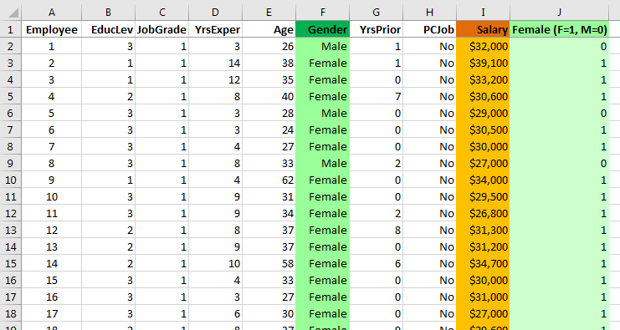
3. Regression with dummy variables
Create a dummy variable from GENDER:
=IF(F2="Female",1,0)

Slide 12
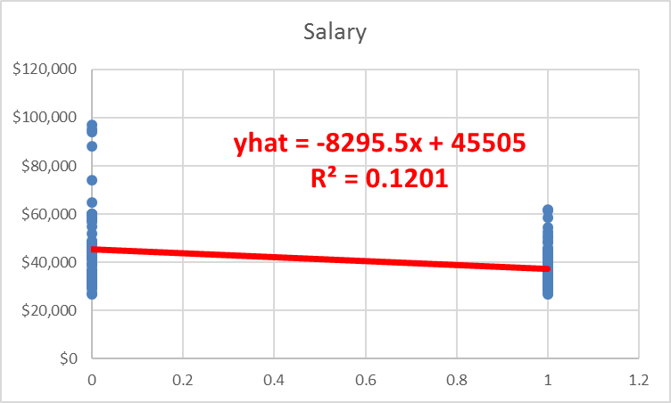


3. Regression with dummy variables
QUESTION: Does gender affect salary?
Include the dummy variable (0=Male, 1=Female) into regression.
M F

Slide 13
3. Regression with dummy variables
Intercept: If it’s a Male worker (dummy=0), then the salary is predicted to be $45,505.4.
Slope: It is predicted that, Female workers are paid $8,295.5 less than Male workers.

Slide 14
3. Regression with dummy variables
Intercept: If it’s a Male worker (dummy=0), then the salary is predicted to be $45,505.4.
Slope: It is predicted that, Female workers are paid $8,295.5 less than Male workers.
Wait!!!
We already saw these numbers before!
“female employees are underpaid by
an average of $8,295.5.”
45,505.4
– 37,209.9
= 8,295.5

Slide 15
3. Regression with dummy variables
Intercept: If it’s a Male worker (dummy=0), then the salary is predicted to be $45,505.4.
Slope: It is predicted that, Female workers are paid $8,295.5 less than Male workers.
The coefficient of the dummy variable in a regression with the dummy as the only predictor simply shows the difference in the averages between the two categories (F and M)!

Slide 16
3. Regression with dummy variables
QUESTION 1: Does gender affect salary?
Explanatory variable: Dummy variable (0=Male, 1=Female).
QUESTION 2: DOES GENDER AFFECT SALARY, AFTER CONTROLLING FOR YEARS OF EXPERIENCE?
Explanatory variables: Dummy variable (0=M, 1=F); YrsExper.

Slide 17
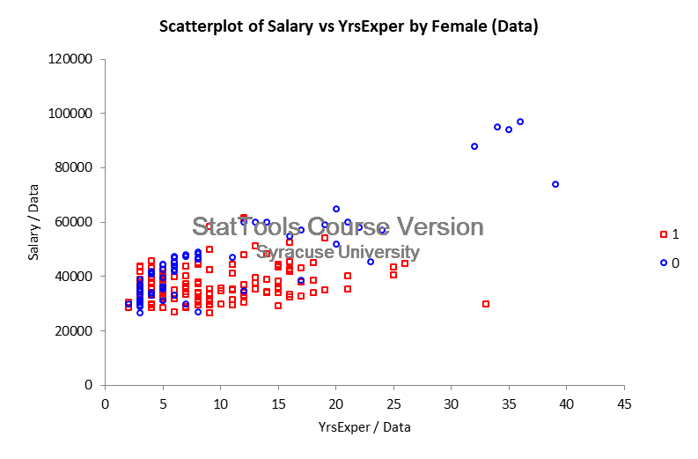
3. Regression with dummy variables
QUESTION 2: Does gender affect salary, after controlling for years of experience?
Include gender dummy & years of experience in the regression model.
Female
Male

Slide 18
3. Regression with dummy variables
QUESTION 2: Does gender affect salary, after controlling for years of experience?
Include gender dummy & years of experience in the regression model.
Regression equation: Predicted salary = 35827.8 + 981.2*YrsExper – 8011.9*Dummy (F=1, M=0)

Slide 19
3. Regression with dummy variables
QUESTION 2: Does gender affect salary, after controlling for years of experience?
Include gender dummy & years of experience in the regression model.
Regression equation: Predicted salary = 35827.8 + 981.2*YrsExper – 8011.9*Dummy (F=1, M=0)
Male (dummy = 0): Predicted salary = 35827.8 + 981.2*YrsExper – 8011.9*0
= 35827.8 + 981.2*YrsExper
Female (dummy = 1): Predicted salary = 35827.8 + 981.2*YrsExper – 8011.9*1
= 27,811.9 + 981.2*YrsExper

Slide 20
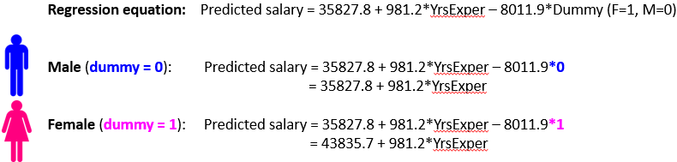
3. Regression with dummy variables
QUESTION 2: Does gender affect salary, after controlling for years of experience?
Include gender dummy & years of experience in the regression model.
27,811.9
Slopes are the same (981.1). Every year of experience is predicted to increase salary by $981.2.

Slide 21
3. Regression with dummy variables
QUESTION 2: Does gender affect salary, after controlling for years of experience?
Include gender dummy & years of experience in the regression model.
27,811.9
Slopes are the same (981.1). Every year of experience is predicted to increase salary by $981.2.
Different intercepts for Females (27,811.9) and Males (35,827.8).

Slide 22
3. Regression with dummy variables
QUESTION 2: Does gender affect salary, after controlling for years of experience?
Include gender dummy & years of experience in the regression model.
27,811.9
Slopes are the same (981.1). Every year of experience is predicted to increase salary by $981.2.
Different intercepts for Females (27,811.9) and Males (35,827.8).
After controlling for years of experience (i.e., holding years of experience constant), Female employees are paid an average of $8,011.89 less than Males.

Slide 23
3. Regression with dummy variables
QUESTION 2: Does gender affect salary, after controlling for years of experience?
Include gender dummy & years of experience in the regression model.
27,811.9
Slopes are the same (981.1). Every year of experience is predicted to increase salary by $981.2.
Different intercepts for Females (27,811.9) and Males (35,827.8).
After controlling for years of experience (i.e., holding years of experience constant), Female employees are paid an average of $8,011.89 less than Males.
The coefficient of the dummy variable in a regression with other control variables simply shows the difference in the intercepts between the two categories (F and M)!

Slide 24
3. Regression with dummy variables
QUESTION 2: Does gender affect salary, after controlling for years of experience?
Include gender dummy & years of experience in the regression model.
27,811.9
Female
Male

Slide 25
3. Regression with dummy variables
QUESTION 2: Does gender affect salary, after controlling for years of experience?
Include gender dummy & years of experience in the regression model.
27,811.9
Male
Female
Female
Male

Slide 26
3. Regression with dummy variables
QUESTION 2: Does gender affect salary, after controlling for years of experience?
Include gender dummy & years of experience in the regression model.
27,811.9
Male
Female
Vertical distance between the two regression lines is 8011.9 !
Female
Male

Slide 27
3. Regression with dummy variables
QUESTION 2: Does gender affect salary, after controlling for years of experience?
Include gender dummy & years of experience in the regression model.
27,811.9
○ Every 1 year of experience is predicted to increase salary by $981.2, for each gender.
○ Holding years of experience constant, Female employees are paid an average of $8,011.89 less than Male employees.
Male
Female
Female
Male

Slide 28
Today: Regression analysis
0. Recall (Lecture 04): Association among numerical variables
Scatterplots
Covariance and Correlation
Simple linear regression
Multiple linear regression
Linear regressions with dummy variables and interaction variables
Nonlinear modeling possibilities

Slide 29
3. Regression with interaction variables
Dummy variables and interaction variables in regression models
QUESTION 1: Does gender affect salary?
Explanatory variable: Dummy variable (0=Male, 1=Female).
QUESTION 2: Does gender affect salary, after controlling for years of experience?
Explanatory variables: Dummy variable (0=M, 1=F); YrsExper.
QUESTION 3: DOES THE EFFECT OF YEARS OF EXPERIENCE ON SALARY DIFFER FOR MALES
AND FEMALES?
Explanatory variables: Dummy variable (0=M, 1=F); YrsExper; Dummy*YrsExper.

Slide 30
3. Regression with interaction variables
What if the slopes are not the same?
Male
Female
Male
Female
○ Every 1 year of experience is predicted to increase salary by $981.2, for each gender.
○ Holding years of experience constant, Female employees are paid an average of $8,011.89 less than Male employees.
○ Every 1 year of experience has a different effect on salary, depending on the gender.
(In this picture, the effect is greater for males than for females)
Different intercepts
Same slopes
Different intercepts
Different slopes

Slide 31
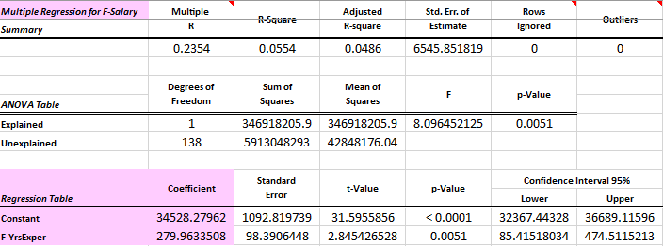
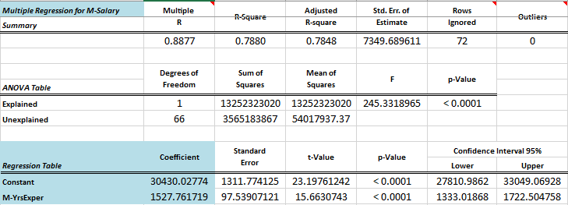
3. Regression with interaction variables
What if the slopes are not the same?
Male
Female
One approach: Run two separate regressions: one for Males, one for Females:

Slide 32
3. Regression with interaction variables
QUESTION 1: Does gender affect salary?
Explanatory variable: Dummy variable (0=Male, 1=Female).
QUESTION 2: Does gender affect salary, after controlling for years of experience?
Explanatory variables: Dummy variable (0=M, 1=F); YrsExper.
QUESTION 3: DOES THE EFFECT OF YEARS OF EXPERIENCE ON SALARY DIFFER FOR MALES
AND FEMALES?
Explanatory variables: Dummy variable (0=M, 1=F); YrsExper; Dummy*YrsExper.
A better approach:
INTERACTION VARIABLE
Dummy x YrsExper

Slide 33
3. Regression with interaction variables
QUESTION 3: Does the effect of years of experience on salary differ for males and females?
Include gender dummy, years of experience, and their interaction term in the regression model.

Slide 34
3. Regression with interaction variables
QUESTION 3: Does the effect of years of experience on salary differ for males and females?
Include gender dummy, years of experience, and their interaction term in the regression model.
Male
Female
Different intercepts (higher for F).
Different slopes (higher for M).
HOW DID WE DO IT ??

Slide 35
3. Regression with interaction variables
QUESTION 3: Does the effect of years of experience on salary differ for males and females?
Include gender dummy, years of experience, and their interaction term in the regression model.
Male
Female
Regression equation: Predicted salary = 30430 + 1528*YrsExper + 4098*Dummy – 1248*Dummy*YrsExper
Male (dummy = 0): Predicted salary = 30430 + 1528*YrsExper + 4098*0 – 1248*0*YrsExper
= 30430 + 1528*YrsExper
Female (dummy = 1): Predicted salary = 30430 + 1528*YrsExper + 4098*1 – 1248*1*YrsExper
= 34528 + 280*YrsExper

Slide 36
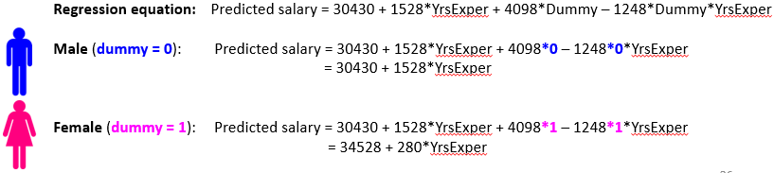
3. Regression with interaction variables
QUESTION 3: Does the effect of years of experience on salary differ for males and females?
Include gender dummy, years of experience, and their interaction term in the regression model.
Male
Female
Different intercepts (higher for F). Different slopes (higher for M).
Every year of experience tends to increase M’s salary by $1,527.8 but increase F’s salary by $1,248 less, i.e., by only $280 (= 1,527.8 – 1,247.8).
For Male employees with 0 years of experience, salary is predicted to be $30,430.
For Female employees with 0 years of experience, salary is predicted to be $34,528 (= 30,430 + 34,528).

Slide 37
3. Regression with interaction variables
QUESTION 3: Does the effect of years of experience on salary differ for males and females?
Include gender dummy, years of experience, and their interaction term in the regression model.
Male
Female
Different intercepts (higher for F). Different slopes (higher for M).
Every year of experience tends to increase M’s salary by $1,527.8 but increase F’s salary by $1,248 less, i.e., by only $280 (= 1,527.8 – 1,247.8).
For Male employees with 0 years of experience, salary is predicted to be $30,430.
For Female employees with 0 years of experience, salary is predicted to be $34,528 (= 30,430 + 34,528).
The coefficient of the interaction variable shows the difference in the slopes between
the two categories (F and M)!

